Slide 1

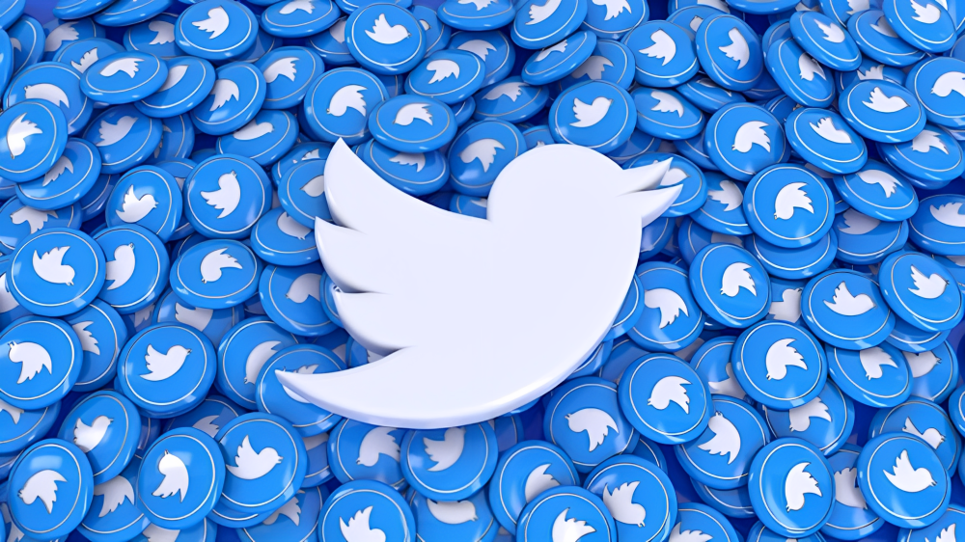

Twitter
Analytics Dashboard
"Twitter is not a technology. It's a conversation. And it's happening with or without you."

Slide 2


Introduction
Twitter analytics dashboard involves aggregating and visualizing data to provide insights into the performance of tweets and user engagement.
Key Features
Tweet Performance Metrics:
Engagement Breakdown:
Audience Interaction:
This dashboard is an essential tool for social media managers, marketers, and anyone looking to enhance their Twitter presence.

Slide 3

Background
In the digital age, social media platforms like Twitter have become essential tools for communication, marketing, and brand engagement. With millions of tweets being sent every day, understanding the performance of these tweets is crucial for individuals and organizations aiming to maximize their reach and impact. A Twitter analytics dashboard serves as a comprehensive tool to visualize and analyze key metrics, providing insights into user engagement and content effectiveness
Key Metrics:
Impressions:
Engagement Rate:
Replies, and Likes:
Profile Visits:
Media Views:
Total Tweets:

Slide 4

Understand Engagement Metrics:
Learn how to interpret key engagement metrics such as impressions, engagements, engagement rate, retweets, replies, and likes to assess the performance of tweets.
Analyze User Interaction:
Gain insights into user interactions by analyzing metrics like user profile clicks, URL clicks, hashtag clicks, and detail expands.
Evaluate Content Effectiveness:
Determine the effectiveness of tweet content by examining media views, media engagements, and app-related actions (app opens and installs).
Learning Objectives

Slide 5
Identify Trends and Patterns:
Use time-based data to identify trends and patterns in tweet performance over time.
Optimize Social Media Strategy:
Develop strategies to optimize social media presence by understanding which types of content and interactions lead to higher engagement and follower growth.
Continued

Slide 6
Skills and Competencies
To develop and effectively use a Twitter Analytics Dashboard, there are several key skills and competencies that are necessary. These skills are typically a mix of technical, analytical, and strategic abilities, which can help individuals interpret the data, optimize their social media strategy, and maximize engagement.
Data Analysis and Interpretation
Key Competencies:
Understanding Key Metrics: Ability to analyze and interpret metrics such as Impressions, Engagement Rate, Replies, Likes, Profile Visits, Media Views, and Total Tweets. Understanding these metrics is crucial for evaluating the effectiveness of content.
Trend Identification: Ability to identify time-based trends and patterns in tweet performance, such as peak engagement times, or days when certain types of tweets perform better.
Segmentation: Segmenting data based on user interactions, demographic info, or tweet types (e.g., media tweets vs. text-only tweets) for more granular analysis.
Engagement Analysis: Understanding the breakdown of user interactions (e.g., replies, retweets, and likes) to evaluate what resonates with the audience.

Slide 7
Continued
Data Visualization
Key Competencies:
Dashboard Creation: Proficiency in creating and managing dashboards that visualize key metrics and trends in a user-friendly manner. This might involve using tools such as Tableau, Power BI, or custom-built solutions with APIs.
Graphical Representation: Ability to use charts, graphs, and tables to represent engagement data in an easily digestible form for stakeholders. This could include time-series graphs, pie charts for engagement breakdown, and bar graphs for performance comparison.
Technical Skills
Key Competencies:
API Usage: Familiarity with Twitter’s API or third-party tools (e.g., Hootsuite, Sprout Social) to pull and integrate data into the dashboard for analysis. Understanding how to use API to gather tweet performance data (e.g., impressions, retweets, mentions).
Data Cleaning and Transformation: Ability to clean and preprocess raw Twitter data before analysis. This may involve dealing with incomplete datasets, removing noise, or normalizing data.

Slide 8
Activity and Task
Low Engagement: The majority of tweets received minimal interaction, with most posts garnering only 0-2 likes and few retweets.
Inconsistent Reach: While some tweets reached a significant audience, the overall impression count varied widely, suggesting inconsistent visibility.
Limited Click-Throughs: User engagement with links, profiles, and hashtags was generally low.
Weak Media Performance: Multimedia content, such as images and videos, did not significantly boost engagement.
Minimal User Actions: Metrics like detail expands, permalink clicks, and app-related activities were largely insignificant.
Ineffective Hashtags: Despite the use of hashtags, click-through rates remained low.
Time of Posting: The timing of tweets did not seem to have a substantial impact on engagement.

Slide 9
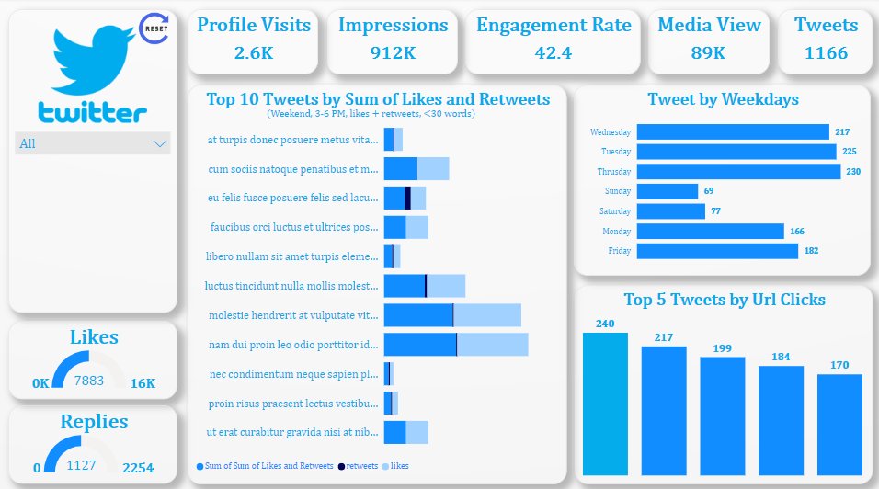

Dashboard

Slide 10
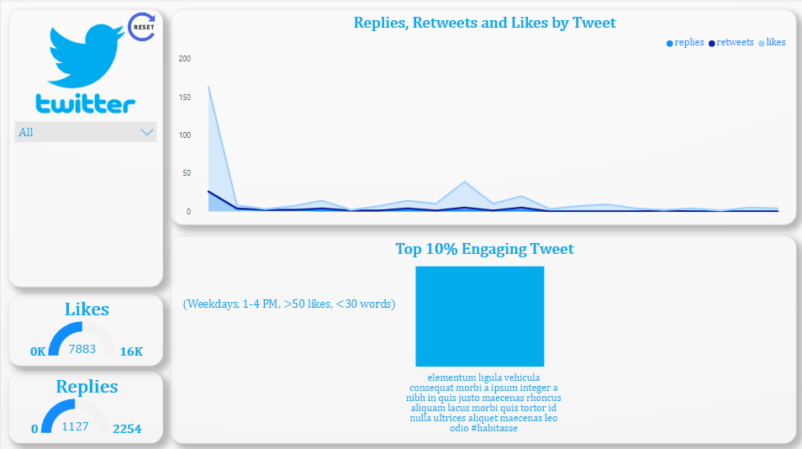
Dashboard

Slide 11
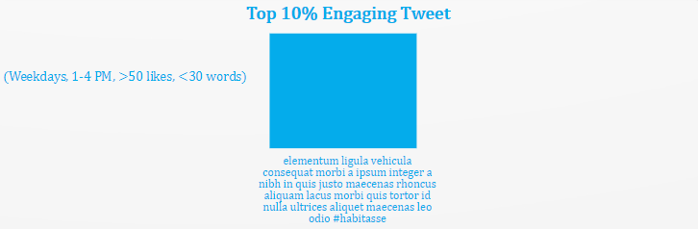

Task 1.
Develop a chart that displays tweets with the highest engagement rates (top 10%). Include only those tweets that have received more than 50 likes and were posted on weekdays and this graph should only work between 1 PM to 4PM as well as tweet word count be below 30.

Slide 12
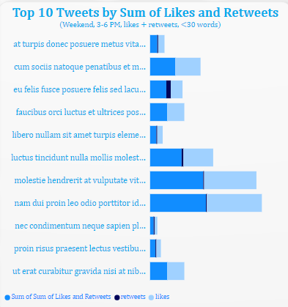
Task 2.
Build a chart to identify the top 10 tweets by the sum of retweets and likes. Filter out tweets posted on weekends and show the user profile that posted each tweet and this graph should work between 3 PM to 6 PM and the tweet impression should be even number and tweet date should be odd number as well as tweet word count be below 30.

Slide 13
Task 3.
Develop a visualization that compares the number of replies, retweets, and likes for tweets that have received media engagements greater than the median value. Include a filter for tweets posted in between June and August of 2020 and this graph should work between 3 PM to 6 PM and tweet date should be odd number and media views should be even number as well as tweet word count be below 50.

Slide 14
Feedback and Evidence
Twitter dataset spanning from June to October 2020, there were 1,166 tweets that generated nearly 912,000 impressions and over 92,000 total engagements. The average engagement rate was 3.64%, with tweets collecting 7,883 likes and 471 retweets in total. The engagement trend shows several notable spikes in user interaction, particularly in late June and mid-September. The most engaging tweet received 54,098 engagements and 2,487 likes, demonstrating significant reach and audience interaction.
Key Metrics:
Impressions:
Engagement Rate:
Replies, and Likes:
Profile Visits:
Media Views:
Total Tweets:

Slide 15
Challenges
Data Quality Issues:
Missing values in impressions, engagements, and engagement rate columns
Inconsistent time format needs standardization
Some metrics have zero values that need investigation
Metric Correlation:
Need to establish relationships between engagement metrics
Understanding which factors drive higher impressions
Temporal Analysis:a
Time-based patterns need proper datetime formatting
Seasonal trends analysis required
Content Analysis:
Tweet text needs preprocessing for sentiment/topic analysis
Hashtag effectiveness measurement

Slide 16
Solutions
Missing Values:
Imputation: Use techniques like mean, median, or mode imputation for numerical data.
Prediction: Employ machine learning models (e.g., regression, decision trees) to predict missing values based on other features.
Deletion: Remove rows with missing values if they are a small percentage and won't significantly impact analysis.
Inconsistent Time Format:
Standardization: Convert all timestamps to a uniform format (e.g., ISO 8601) using libraries like datetime or pandas.
Zero Values:
Investigation: Analyze the underlying reasons for zero values. Are they genuine or errors?
Outliers: Identify and handle outliers using techniques like Winsorization or capping.
Data Cleaning: Remove or correct erroneous zero values.
Metric Correlation
Correlation Analysis: Use Pearson's correlation coefficient or Spearman's rank correlation to measure the strength and direction of relationships between engagement metrics.
Visualization: Create scatter plots or correlation matrices to visualize the relationships.

Slide 17
Solutions
Temporal Analysis:
Datetime Formatting: Convert timestamps to a suitable datetime format for time-series analysis.
Time-Based Patterns: Use time-series decomposition to identify trends, seasonality, and cyclic patterns.
Seasonal Trends: Analyze data across different seasons to understand seasonal variations in engagement.
Time Series Forecasting: Use models like ARIMA, Prophet, or LSTM to predict future trends.
Content Analysis:
Text Preprocessing:
Cleaning: Remove stop words, punctuation, and special characters.
Tokenization: Break text into words or tokens.
Stemming/Lemmatization: Reduce words to their root forms.
Sentiment Analysis: Use sentiment analysis libraries (e.g., VADER, TextBlob) to classify tweets as positive, negative, or neutral.
Topic Modeling: Employ techniques like LDA or NMF to identify underlying topics in tweets.
Frequency Analysis: Analyze the frequency of hashtags used.
Engagement Correlation: Correlate hashtag usage with engagement metrics.

Slide 18
Outcomes and Impacts
The Twitter Analytics Dashboard provides users with data-driven insights that can directly influence social media strategies and improve overall Twitter presence. By leveraging key metrics and understanding user engagement, individuals and organizations can experience several valuable outcomes and impacts:
1. Improved Content Strategy
Outcome: Users will gain a clear understanding of which types of tweets (e.g., images, videos, links, hashtags) resonate most with their audience.
Impact: With this knowledge, content can be tailored to increase engagement, improving the relevance and appeal of tweets. This leads to more effective use of media (e.g., videos, images) and text to capture audience attention.
2. Higher Engagement Rates
Outcome: By analyzing engagement metrics such as likes, retweets, replies, and clicks, users can determine which tweets encourage the most interaction.
Impact: With insights into high-engagement content, users can replicate successful strategies and improve their overall engagement rate, leading to more active followers and increased visibility.

Slide 19
Outcomes and Impacts
Optimized Social Media Strategy
Outcome: Time-based data and pattern analysis will allow users to identify peak times for engagement, as well as the best performing content categories.
Impact: Social media managers and marketers can schedule tweets at optimal times and focus on creating content that their audience is most likely to interact with. This optimization helps maximize reach and impact, improving both short-term results and long-term growth.
Better Understanding of Audience Behavior
Outcome: The dashboard provides data on user interactions, such as profile visits, URL clicks, and hashtag engagement.
Impact: This insight helps users understand what drives people to engage with their content Increased Follower Growth
Outcome: Understanding which types of content lead to higher engagement helps users produce tweets that are more likely to be shared and followed.
Impact: By consistently creating high-quality, engaging content, users can experience sustained follower growth and community building.

Slide 20
Conclusion
Low Engagement: The majority of tweets received minimal interaction, with most posts garnering only 0-2 likes and few retweets.
Inconsistent Reach: While some tweets reached a significant audience, the overall impression count varied widely, suggesting inconsistent visibility.
Limited Click-Throughs: User engagement with links, profiles, and hashtags was generally low.
Weak Media Performance: Multimedia content, such as images and videos, did not significantly boost engagement.
Minimal User Actions: Metrics like detail expands, permalink clicks, and app-related activities were largely insignificant.
Ineffective Hashtags: Despite the use of hashtags, click-through rates remained low.
Time of Posting: The timing of tweets did not seem to have a substantial impact on engagement.
%. The reach of the tweets has been inconsistent, and the use of multimedia content and hashtags has not significantly boosted engagement.
To improve performance, strategies such as creating high-quality content, optimizing posting times, engaging with the audience, and using paid advertising can be considered

Slide 21


Thank You!

